Slide 1
K-FOLD CV PAIRED T-TEST

Slide 2
INTRODUCTION
k-fold cross-validation (CV) is a technique used to evaluate the performance of a model.
It involves dividing the dataset into k equal parts, using k-1 parts for training the model and the remaining part for testing.
The paired t-test is a statistical test used to determine whether there is a significant difference between two sets of paired data.

Slide 3
K-FOLD CV PAIRED T-TEST
If the p-value of the t-test is below a predetermined significance level (typically 0.05), we reject the null hypothesis and conclude that there is a significant difference in performance between the two models. Otherwise, we fail to reject the null hypothesis and conclude that there is no significant difference in performance.

Slide 4
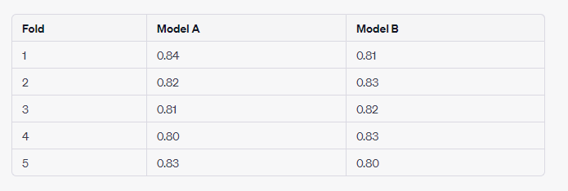
PROBLEM :
A company is developing a machine learning model to predict customer churn. They have developed two different models, Model A and Model B, and want to determine which one performs better on a dataset of 1000 customer records. They decide to use k-fold cross-validation with k=5 and perform a paired t-test to compare the performances of the two models. The following table shows the accuracy scores of each model for each fold:
Perform a k-fold CV paired t-test to determine whether there is a significant difference in performance between Model A and Model B.

Slide 5
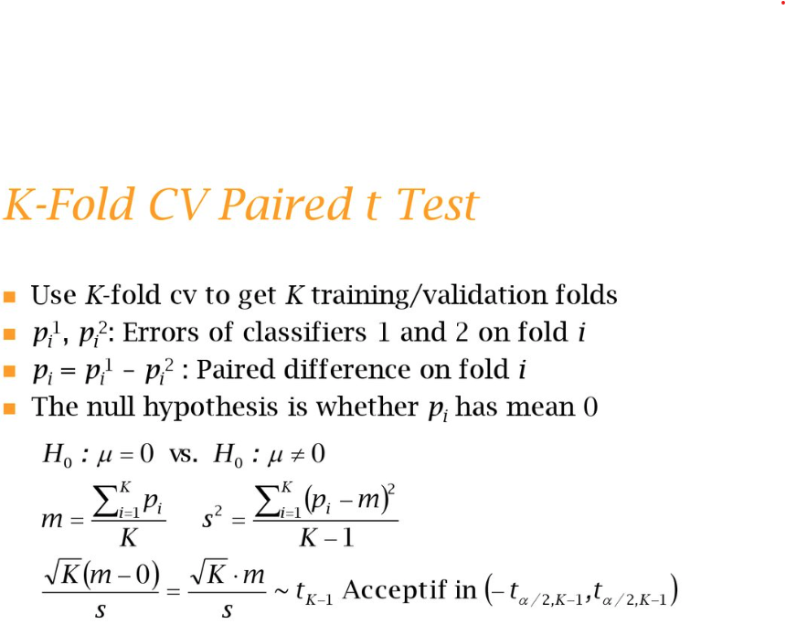

Slide 6
Find :
Difference between two models
Mean
Standard Deviation
Find t-statistic
Find p-value

Slide 7
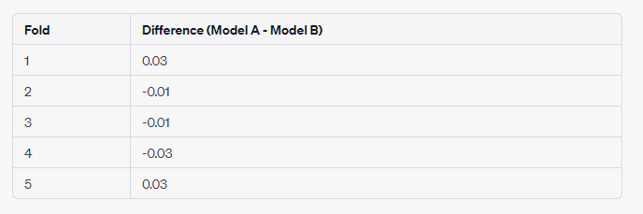
Solution:
To perform a k-fold CV paired t-test, we first calculate the difference in performance between the two models for each fold:
Next, we calculate the mean and standard deviation of the differences:
Mean = (0.03 - 0.01 - 0.01 - 0.03 + 0.03) / 5
= 0
Standard deviation = sqrt([ (0.03 - 0)^2 + (-0.01 - 0)^2 + (-0.01 - 0)^2 + (-0.03 - 0)^2 + (0.03 - 0)^2 ] / (5-1))
= 0.023

Slide 8
We then calculate the t-statistic:
t = Mean / (Standard deviation / sqrt(k)) = 0 / (0.023 / sqrt(5))
= 0
Finally, we calculate the p-value using a t-distribution with 4 degrees of freedom (k-1):
p-value = 2 * (1 - tcdf(abs(t), df=k-1))
= 2 * (1 - tcdf(0, df=4))
= 2 * 0.5
= 1
Since the p-value is greater than the significance level of 0.05, we fail to reject the null hypothesis and conclude that there is no significant difference in performance between Model A and Model B. Therefore, we cannot determine which model performs better based on this analysis.

